Slide 1

My truth
My responsibility

Slide 2
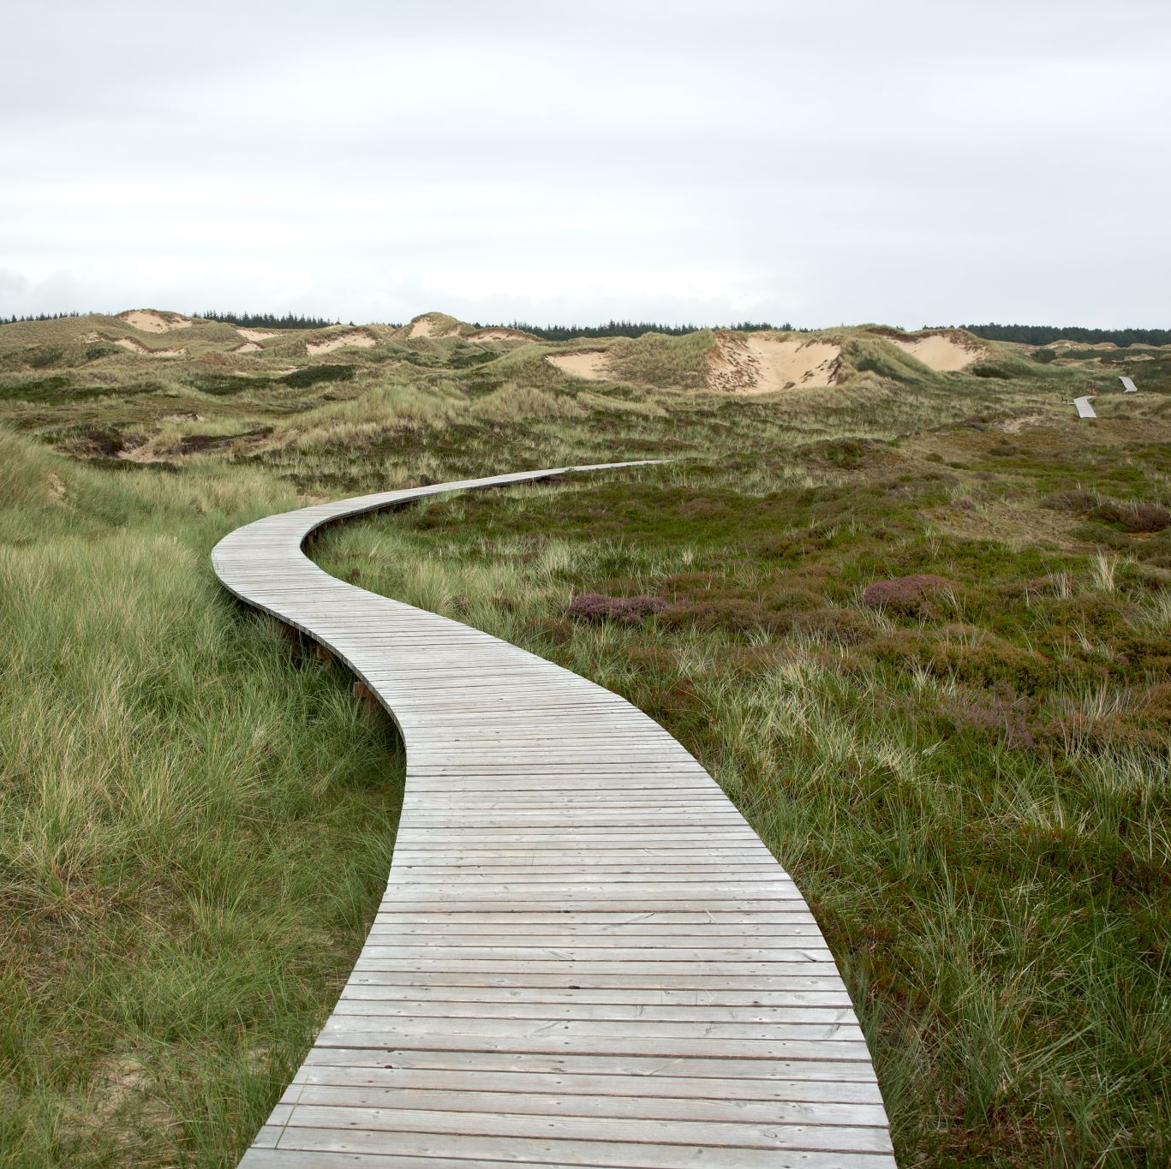
My Truth
Who Am I?
Why am I here?
What is my purpose?
Am I real?
am I Truthful? Do I have integrity? Am I reliable?
Am I truly who I think I am?
Am I truly what I appear to be to others?
What am I to become and how can my truth help me and others?

Slide 3
My Truth
What do I understand by Truth? And why?
How is ‘Truth’ any different to ‘My Truth?’ Does my truth belong to Me or to Truth which is Above me? Should my truth be shared with others?
Is my own path the only one to Truth? How many paths can lead to Truth? How many paths walk on ‘my Truth?’ or am I alone on my journey to find my Truth?
Am I able to join another in their unique path to Truth through Love?
Have I ever been able to know Truth completely or is it always a journey?
Does Truth have a Beginning? An End? How does Truth relate to the concept of Time and destiny?

Slide 4
My Truth
Is there a Truth Higher than that of my own?
Do I have access to all my questions within me?
Do I ever stop learning?
Can I ever hold truth in my hands?
Was I not created in Truth? Is not all of Reality created with a Word of Truth? And what is the word of Truth if not the word “Be!”? How can I seek to ‘Be’ part of Reality without seeking and speaking truth? How can I become creative with my gifts and blessings without being connected to my Life Force that created me out of nothing?

Slide 5
My Truth
Am I truthful all of the time, some of the time or none of the time?
Am I truthful in the way I think? How can I become more truthful in the way that I think?
Am I truthful in the way that I speak? How can I become more truthful in what I speak about?
Am I truthful in the way that I act? How can I become more truthful in my behaiour?
Is what I think say and do all lined up together in my Truth? Or am I a hypocrite? How does this affect my ability to know who I am?

Slide 6
My Truth
How do I know that my truth which is different to your truth is true truth?
How can I seek truth in a way that I truly believe the authenticity of my truth and so that the truth becomes part of who I am and who I want to become?

Slide 7
My Truth
Am I able to seek truth by asking myself what is true when I cannot even distinguish between the authenticity of my truth compared to your truth without a doubt in my heart?
Is it True that I exist? But is it not also true that You exist? So If you and I are both part of reality and if all reality has Truth in it, then surely there must be a Creator that is Higher than its creation that can guide us to the Higher Truth than only that of you and me?
Am I able to seek Truth from that which is Higher than myself within myself by using my reasoning and intelligence so that I can better understand and love it? Will I not become more able to express through speech and action – the truth which I truly love and understand and do not doubt?

Slide 8
My Truth
Is my Truth the same truth that my parents passed onto me? Have I questioned their authenticity?
Is my Truth the same truth that my friends have advised me? Have I questioned their accuracy?
Is my truth the same truth that my teachers taught me? How do I know that everything I have been taught is in fact true?
How can I find Truth without seeking it with a sincere heart? How can I get closer to my truth without asking questions and seeking the answers and challenging those who teach me?

Slide 9
My Truth
Should I rely and trust everything that others say without evidence?
If I ask ten different people a question and there are ten different possible answers- how do I know which is truth?
How can I know what is right from wrong without an ability to make my own judgement? What does my judgement depend on?-
What do I rely on to help me to judge right from wrong? And truth from falsehood?

Slide 10
My Truth
Can my emotional experiences help me decide what is right from wrong? But my emotions change all the time- how can my Truth be dependent on something that can change so much from one day to the next? How can my Truth be reliable if it can change with emotion?
Can my experiences driven by my evil inclinations help me to decide what is right from wrong? But if my Truth is based on the level of my greed, ego, lust, slot, envy, anger and vengeance then how will I ever be able to serve a Truth that is higher than my own understanding of truth? How can I use this truth to cause anything other than destruction and harm unless I repent and mend my ways and use the wisdom I have found in this truth to help me then serve a Higher Purpose?

Slide 11
My Truth
Can knowledge help me to find my Truth?
Can wisdom help me to find my Truth?
Can Understanding help me to find my Truth?
Can Love help me to find my Truth?

Slide 12

My Truth
What is Reality? Can anything be Real if it has no truth to it?
Are there different levels of Reality depending the amount of Truth within it?
Why is it important to distinguish truth from falsehood?
Why is it important to distinguish right from wrong?
Why is it important to distinguish Reality from Delusion?
Is my life real or just a delusion?
Is my Truth and Reality defined by what I perceive with my physical senses or is Truth beyond my own Perception?

Slide 13
My Truth
Can self judgement and self reflection help me to find truth and therefore good in my soul and enable me to better and more clearly see the good and truth in others?
How can seeking truth and my ability to judge right from wrong enable me to see more clearly so that I can remove the plank from my own eye and help to remove the dust from the eye of my fellow human?
How does my seeking of truth affect my ability to see more clearly? How can Seeking Truth, being more truthful and Integrity help me to see with my heart that which my eyes do not see? How can I find a treasure that I do lot seek? How can love enable me to see and reach out for the hand of Truth that is waiting for me to cleave to it?

Slide 14
My Truth
How does Truth relate to:
Awe
Sincerity
Knowledge
Understanding
Wisdom
Love
Humility

Slide 15

My Truth
How can I seek Truth without fear and Awe?
How can I ‘know’ Truth without Knowledge?
How can I truly understand Truth without experience?
How can I truly apply Truth without wisdom?
How can I truly Trust in Truth without Faith?
How can I touch Truth without Love? How does my arrogance prevent me from finding and following my path towards Truth?

Slide 16
My Truth
How can I seek and find Truth without questioning?
How can my intellect, logic and reasoning help me in my quest for Truth?
Can my mind ever deceive me?
Can my heart ever deceive me?
Are my heart and mind able to work together in Unity?

Slide 17

My Truth
Does Truth make room for contradiction? Can truth and falsehood mix and merge or is there a hidden barrier between them?
Are two opposites able to both be part of the same Reality?
Does darkness occupy its own space? Is there room for falsehood in this world or does everything contain an element of truth in my physical Reality?
Is there Truth in Falsehood? Is there good in evil? Is there Light in Darkness? Is there wisdom that be gained from negativity? Is there knowledge to be found in that which is temporary?
Is there understanding that can be discovered from my enemy?
How can making space for that which I perceive to be in opposition to my truth and identity -help to elevate and transform my perception of Truth and Reality?
How can the existence of contradiction and opposites help me find a Higher Truth?

Slide 18
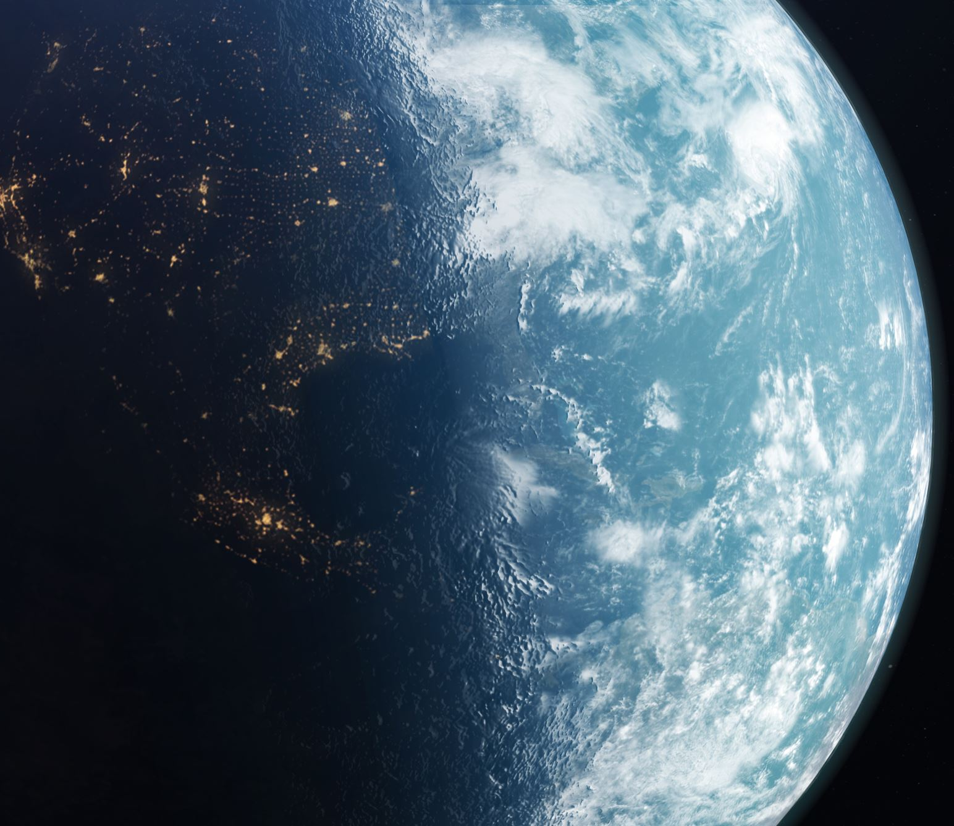
My Truth
How does Truth relate to Light? Is Darkness a part of Reality or is it simply a lack of Light?
What is the space that occupies the darkness? Is there a reality to the space in which there is no light?
How would I understand Light without The Darkness? Are Truth and Light the Same Reality? Are Falsehood and Darkness the same reality or do they just share the same space?
Is falsehood a real existence or is it just a lack of Truth? How can something that is not true or real, ever Be?
What or Who is the Source of Light? What or Who is the Source of Truth? What or Who is the Source of the word “Be!”? The Source of Life?
How can anything or anyone ‘Become’ what they are without a Higher Truth except for the Source of all Truth?
How can anyone or anything ‘become’ who or what they want to become without freewill in truth in speech and behaviour?
How can anyone or anything know that their expression of truth in their speech and behaviour is truly Truth, without seeking a Higher Truth and connecting to it?
How can our truth be effective in creation if it is not Real?
How can we come closer to Truth if there is no space for falsehood or darkness to exist in Reality?
How can the Human being that is Me, find and shine the Light of Truth of my soul in the space of darkness of my physical being- in space which I occupy, within myself, the world of creation and others in order to bring Peace and Love and Justice to the worlds?

Slide 19
My Truth
How does the reality of who I am relate to True Reality?
How do I relate to Truth?
How does the truth in me relate to who I am?
Am I truly who I think I Am?

Slide 20
My Truth
Do I choose to serve the Source of my Truth or does my truth serve me?
How can I come to serve a Higher Truth if I have not found the truth that is within me without having my own identity?
How can my truth have a relationship with a Higher Truth if my own truth does not have an identity of its own?
How can I get closer to knowing Truth without remaining separate from it?
How can I become One with Truth if I do not seek to have a relationship with It?
How can I desire to seek Truth if I do not recognise it as Home? How can I recognise it as Home if I am not familiar with it? How can I be familiar with Truth if I do not incorporate it into my own thoughts speech and behaviour?

Slide 21
My Truth
Am I Real? If so- how Real am I?
Is my truth mixed with falsehood? If not- how can I be sure? Do I doubt my own truth?
How do I know which part of me is the Real True me and which part is not really me?
Am I able to choose who I want to be? Am I able to use my freewill to refine my true identity in a way that I choose?
Do I have the ability to choose Truth over Falsehood? But how can I do this without seeking Truth? How can I find truth in my identity without learning how to distinguish truth from falsehood and right from wrong?
Is my reality defined by what I think and say and do? Or is my reality defined by what I believe in my heart to be Truth?
Must I express the belief of the truth in my heart using my speech and action in order to make it part of Reality?- if not then how can I say I am what I am?
How can I have any identity of my own without the expression of my Truth?
What is the purpose of my existence if I cannot truly be Me and become what I am meant to become?

Slide 22
My Truth
What is my potential?
How do I define my potential?
Is my potential limited by my perception and interpretation of it? If so- is not my own understanding of truth not also limited by my own perception and interpretation of it?

Slide 23
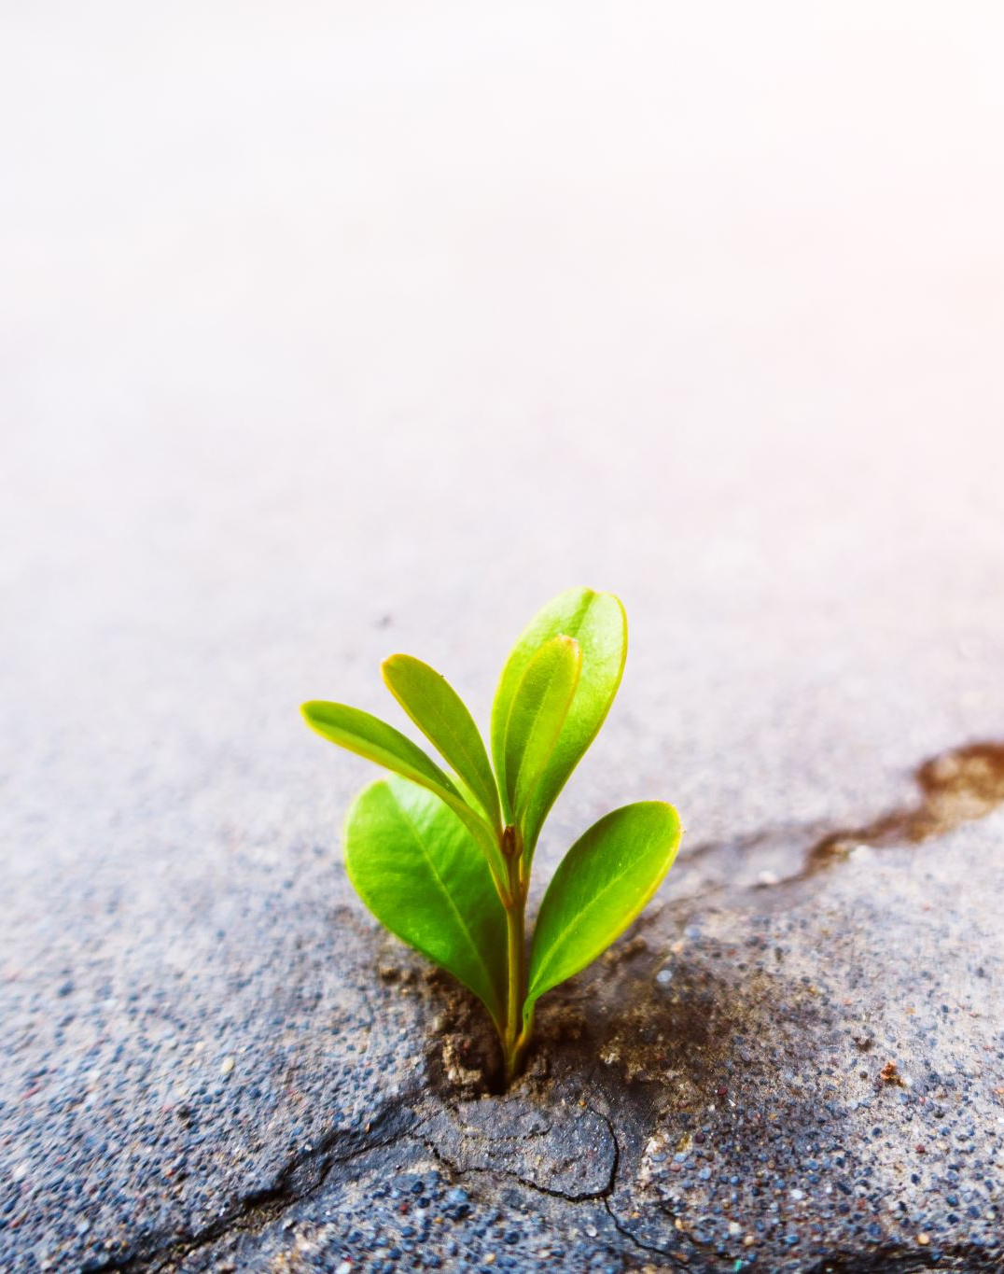
My Truth
Does ‘Truth’ change?
Does True Reality stop existing if it is True?
Is Truth ever destructible?
Can Truth change from one form to another?- If so how?
How could the physical world exist or be part of Reality without Truth?
On what can we rely if not the Truth?
How can we have meaningful relationships with our Creator, ourselves and one another without Truth?

Slide 24
My Truth
What is my understanding of ‘Falsehood’? What is Delusion? How false am I? Do I say what I mean? Do I do what I say? Am I a liar? Do I deceive myself and others? Do I give false witness to truth? Do I cheat and give others less than their due? Do I break my commitments and promises? Do I change my mind once I have made an oath or a vow? How can I judge right from wrong? Am I losing my sense of ‘guilt’? How do I feel when I am faced with the Truth? Does it hurt me? Does it destroy me? Do I feel ashamed in front of it? Do I run away from it back into exile? How temporary is my state of being? How can I physically and spiritually become more able to bear the Truth and to recognise it when it comes unless I choose myself to become more truthful in my thought speech and behaviour and lead a more honest life?

Slide 25
My Truth
Does Falsehood change? Does it not deceive? Does it not lie? Does it not betray? Does it not lead astray? Does it not cause division and break down relationships? Does it not disconnect our direct relationship with our Creator? Does it ever lead to everlasting destruction or is it ultimately always destroyed by Truth? How could the spiritual world within humanity exist or be part of Reality without falsehood in this physical world? How can becoming more able to distinguish truth from falsehood enable me and others to find and connect to our spiritual Source of existence, recognise our purpose in this physical world and transform Darkness into Light, destroying falsehood with Truth, and help to create a Home of Eternal Peace?

Slide 26
My Truth
If all that I am is false and deceitful and part of a reality that is in fact a delusion- Do I have any chance to stand in front of my Creator who created me in Truth? Does the falsehood of my evil inclination have any chance to stand in front of my Truth- will my choice to lead a more honest life not help me to destroy the part of me which invites to my own destruction and the destruction of others?

Slide 27
My Truth
What do I understand by My truth VS Truth?
Must I ‘see’ or ‘hear’ or ‘feel’ Truth in order to accept it into my heart and Believe in it?
Is there nothing Higher than Myself and my human perception of Truth that is Real?
Is something not able to exist in space and time outside of my own limited physical perception of it?- If so- then Is the path to Higher Truth not an infinite journey through my personal growth, self-reflection and expression of my limited perception and understanding of my truth?
If there is always something Higher than that which I can become, then how can I ever escape this journey? Does my free will allow me to decline this task that I have taken on or can I only choose my direction?

Slide 28
My Truth and my Covenant
How can I have free will if I have been forced to Be? Is it possible that I have chosen to come into this world in order to fulfil a purpose? Why can’t I remember? Did I make a covenant with my Creator? Did I make a Vow? Did I make a commitment? Can my path of seeking Truth help me find the answer to this question? Who am I? Why am I here? What is my Purpose?
How can keeping my oaths, vows, commitments and covenants that I do remember making with others in my family and work life- help me to remember whether or not I made a covenant with my Creator- and what the exact nature of this covenant was?

Slide 29
My Truth
Is the Truth that I speak- fact or opinion?
Is the truth that I speak beneficial or harmful?
Is the truth that I speak Kind?
Does what I speak of my Truth cause division or make peace?
Is my Truth a double edged sword?

Slide 30
My Truth
Why do I refrain from speaking and becoming One with Truth in certain circumstances? How will my truth affect those who have ears with which to hear? How will my truth affect those with hearts with which to understand? How will my truth affect those who have eyes with which to see and recognise it?
Will I be questioned?-perhaps I question my own truth? Will I be doubted?-perhaps I doubt my own truth? Do I fear being judged wrongly because of my truth?- perhaps my truth is not yet able to help me judge myself right from wrong?
Do I fear mistreatment because of my truth? Perhaps I do not yet understand that my truth cannot be mistreated if it is in fact Truth? Do I fear oppression from speaking the truth more than the destruction of myself with the same truth that I choose not to express?
Do I fear expressing Truth more than I fear Truth itself?

Slide 31
My Truth and my Ego
Is there no truth that is Higher than me? Who do I choose to serve with my truth? Do I use my truth to serve my own will and purpose or to serve the Will and Purpose of that which is Higher than me through serving creation?
How can I serve that which is Higher than me, and serve others out of love- if my ego stands in my way and is bound up with my limited understanding of my truth and purpose? Does my ego define my truth or does my truth define my ego?
Is that which I know and learn because of me or does it come from that which is Higher than Me?
What is more important to me?- To seek Truth or to become Truth? To seek an answer to my question or to answer the question of another? The Outcome or the Journey? The possession or the company? To become or to seek? To seek truth in an argument or to win an argument? To rise or fall? To be United or divided?
Does Truth belong to me? Is it Mine? Or is it from something that is Higher than Me? Is my truth the whole Truth or just one perspective of it?
Is my understanding of truth more important than the understanding of someone else’s truth or are both valid and open to questioning in the same way? Is my truth worthy of my worship or is it the Source of my Truth that is worthy of my worship?
How does my arrogance lead me to destruction and delusion?

Slide 32
My Truth and my Humility
Am I able to seek Truth if I believe that I already am what I am meant to become?
Why would I seek to gain knowledge wisdom and understanding if I know everything already?
Is there no Truth Higher than Me?
Did I create myself or was it a Higher Truth that Created me? How can my humility help me to recognise the servant nature of my truth?
How can my humility help to remind me not to become judgemental of the understanding of truth of others and thereby cause division and separation?
How can my humility in truth seeking bring me to listening more to others’ perspectives so that I can also come to see Truth through the eyes of others and not just my own?
How can humility help me to seek Everlasting Truth in Peace rather than seeking to control others with my own limited perception of my own reality- thereby leading to the descension of myself and division of those around me?
How can rising above my ego of my truth through humility in Truth help me to continue to grow and become more fruitful in my life so that I can serve my Creator and better serve others? How can my humility help me to purify and transform my truth into a Higher Truth with a Higher Purpose through connecting with and becoming One with my Creator- The One, The True Reality?

Slide 33
My Truth and my Lust
Do I choose to put a veil over my eyes in front of Truth- because of my lusts and animal desires which give me a temporary pleasure in this worldly life?
Does my truth serve my lust or does it serve a Higher Purpose?
Do I change my truth knowingly in order to validate my inability to control or refusal to control my passion and lusts which give me self pleasure?
Do I close my eyes and put my hands over my ears and turn my heart away from facing, hearing and understanding Truth because I choose instead to cling to the Lust of my heart which I serve and which serves only me?
How do my lusts change my perception of my truth? Can I rely on my lust to save me? Will it desert me one day?
How can acknowledgement of the harm that is caused by allowing my lust to define my truth help me to choose and become more able to transform my lustful truth to one that is led by unconditional love? – The side of me that wants to serve You?

Slide 34
My Truth and my Love
How can loving for others what I love for myself help me to become more truthful and willing to express and share my truth with others?
How can my truth help me to feel more able to express my vulnerabilities and make room for others to share their vulnerabilities with me? How can this help to give myself and others a meaningful sense of purpose and acceptance and teach us mutual respect in Love?
How can unconditional love help me to feel more able to become more honest and truthful in my thoughts speech and action, and lead a life of integrity?
How can loving that which is Higher than myself help me to choose to serve a Higher purpose with my limited understanding of Truth, thereby opening the gateways to learning and seeking a Higher Truth through love?
How can love of my Creator and for others teach me to stand up for Truth even if it goes against my physical self?
How can Love for Higher Truth help me to become more joyful about Truth seeking thereby helping me to rise up above my lust which drags me down to cling to the falsehood and temporary nature of the physical pleasures of this worldly life so that I can serve a Higher more lasting Purpose of Reality?
How can Love bring me to see with my heart that which my eyes do lot see? To see the treasure of Truth, wisdom and understanding in places that are hidden?

Slide 35
My Truth and my Greed
What is the relationship between my greed and my truth?
How does my greed cloud my vision of Truth? How does my greed affect the way I choose to define my truth and reality?
Is my understanding and definition of my truth driven by my greed for power? Or my greed for wealth? Or my greed for anything of this physical world?
Do I run away from facing or hearing or understanding Truth because I do not want to let go of my greed which imprisons me, deludes me in my false short lived pleasures and serves my own temporary purpose?
How does my refusal to acknowledge Truth due to my greed affect my relationship with my Creator- myself and others?
How does my own understanding of my truth that is defined by my greed help or prevent my ability to bind to and connect with a Higher Truth?- The Creator of my Being?
Can seeking and pursuing the path of Truth help me become more Compassionate and Just and therefore help me to rise above my greed?

Slide 36
My Truth and my Compassion
What role does my compassion play in my truth?
Do I express my truth in a way that is compassionate?
Do I express my compassion in a way that is truthful and with integrity?
How can I reach my true potential in the expression of my Truth without my compassion for others?
How can my compassion for others help me to express my Truth in a way that is less destructive, and more inspiring to others?
How can my compassion be Real without Truth?
How can working on my compassion and love help me to serve a more lasting Higher Truth and purpose through rising above my greed which deceives me and makes me desire possessions that I cannot take to my grave?
How can expressing my compassion towards others help myself and others to become more willing and able to seek truth, think truthfully, express my truth in my speech and behaviour and help others with it?
How can becoming more compassionate in the way I choose to seek and express my truth increase the power and effectivity and creativity that results from the expression of my truth?

Slide 37
My Truth and my Anger
What role does my anger play in my ability to seek and express my truth?
Is my truth expressed with anger? How does my anger affect the power and effectivity of my truth? Are others more or less likely to listen to my truth when I am angry or patient?
Do I seek vengeance and destruction through my expression of my truth?
Does my truth cause others to become angry?- if so- how does this affect the quality of our relationship?
Does my expression of my anger in my truth lead to division or peace?
Does the expression of the truth of others to me cause anger within me towards others?
Why do I get angry when I am faced with the truth? Or is the expression of opinions of others that are false which angers me?- How can this help me to empathize with how others might react to my expression of truth when it is not authentic? How can my anger in response to the opinions or expression of truth of others help me recognise the parts of myself that I need to work on to become more authentic myself?
Is my physical and spiritual and emotional and mental Being not able to bear the Truth? Or is it not able to bear Falsehood? Is my Truth not able to destroy the falsehood that it is faced with?- If so- then why get angry about it?
Perhaps my anger helps to fuel the passion and flame of my Truth so that it can destroy falsehood?
How can I transform my negative anger into a positive flame of passion against falsehood so that it increases my ability to seek truth, and increases the power and strength of my truth? – Must I not seek to connect with a Truth higher than that of my own through patience and self-discipline in order to be able to do this?

Slide 38
My Truth and My Patience
What role does my patience play in my truth?
Am I patient with my truth-seeking behaviour?
Am I patient with my expression of my truth?
Am I patient with others when they express their opinions and versions of their understanding of truth to me?
How can my patience in truth seeking and self expression help me to persevere in being who I am and becoming who I will become by surrendering to a Higher Truth in the face of the challenges which test and oppose and question my Faith?
How can my patience in seeking help from The Source of my Patience, and perseverance in performing acts of loving kindness help me to become more truthful, and more able to be a vessel of Light and Truth, so that I can become what I am needed for rather than what I want to become for my own purposes according to a Will greater than my own, a Will that is in line with the Source of my Truth?

Slide 39
My Truth and my Hatred
How does my hatred for myself and others affect my ability to seek Truth and be more true to myself and my Creator?
How does my hatred towards another affect my ability to gain wisdom and understanding and knowledge from that person?
How does my hatred towards myself affect my ability to not hate others?- How does it affect my ability to learn from my past wrongdoing and gain wisdom from them, in order to transform falsehood in Truth and darkness into Light?
Am I more or less willing and able to allow Truth and Light into the space of darkness in my soul if I hate it?
Do I hate Truth? How can I seek and be more able to express truth and therefore be more true myself if I hate the Source of my own True existence and True purpose?
How can I transform my hatred of Truth, myself and others through working on my Gratitude, into a hatred of falsehood- so that I can then use this as fuel for my flame that burns away all that is false about me and becomes a Fire of Truth?

Slide 40
My Truth and my Gratitude
Can I be false and grateful at the same time?
Am I grateful for my ability to seek and find and reveal Truth?
Am I grateful for my ability to become me through Truth?
Am I truthful and sincere about my expressed gratitude- or do I give in order to receive?
Is my gratitude directed at the Source of my Truth and blessings, or is it directed at myself? How can Truth in my gratitude help me to direct my gratitude to my Creator and Source of all my blessings so that I become more able to express my truth and Love more altruistically and Glorify a Higher Truth beyond that of my own existence.

Slide 41

My Truth and my Envy
How does my envy affect my ability to seek and incorporate Truth into my being?
Is Truth not One with True Love? How can I envy that which I truly love?
How can I seek Truth and Love and Peace if I allow my envy to cause division?
How can I truly Love that which I envy? How can I love Truth, seek Truth and incorporate it into my life when I love for myself more than that which I love for others through my envy and greed?
How can facing up to the reality of my envy having control over me, enable me to gain wisdom from my previous wrongdoings and help me to take responsibility over my thought speech and action, transform my envy so that I treat others how I want to be treated so that I come to love for others what I love for myself?
How can my Justice help me to learn truth from my envy?

Slide 42
My Truth and my Justice
How can I become truly Just if I am unable to bear witness to Truth?
How can there be inner Peace without Justice? How can there be Peace in my external physical and spiritual world without Peace in my spiritual and physical heart mind and soul? Must I be a witness against myself in Justice to achieve inner Peace?
How can my truth destroy through Justice (and therefore bring me Peace) the part of me that is not my true reality or who I want to be, if my Truth is not in Line with the Source of my Truth?
How can I seek and incorporate Justice into my life without seeking truth through knowledge wisdom understanding and bring it into my love?
How does my injustice which results from my lack of respect and love for others as myself prevent me from seeking, receiving and revealing Truth in a way that benefits and serves a Higher Purpose beyond myself?
How can my love for Truth enable me to express my love for Justice?
How can my Love for Justice enable me to express my love for Truth?
How can my Truth be used as a weapon for Justice? What can better bring Justice to my inner world?- a gun, a knife or becoming more True to myself, seeking and expressing my Truth?
Can I be face to face with my Truth and allow it to burn away the falsehood that has wrapped itself around my true essence so that I can be more free to be who I am to become? How can Truth help to sharpen the double edged sword of my Justice so that I am a reliable witness against mysself?

Slide 43
My Truth and my Sloth
Am I too lazy to seek truth and become more truthful?- If so why? Do I choose to put a veil over my eyes and heart and ears so that I do not have to take responsibility for seeking and revealing truth and serving a purpose Higher than my worldly desires? Or does my sloth force itself over me to cover my true essence and prevent me from seeing who I really Am? Does my sloth choose to do this beyond my free will or does my mind allow this to happen?
How can I grow from Truth if I am too lazy to seek knowledge and wisdom?
How can I come to understand Truth if I am too lazy to express my Truth in acts of loving kindness and in pursuing justice?
How can I and others recognise and benefit from my opinions and beliefs if I am too lazy to clarify first that they are in fact truthful?
How can I form meaningful lasting relationships with myself, my Creator and others if I am ignorant, not truthful and too lazy to stay committed to my promises and oaths?
Will my sloth not lead me to destruction without my Truth?

Slide 44
My Truth and my Sorrows
Does the Truth hurt me? Does facing up to the reality of who I really am and need to become upset me? If so- why? Is it more than I can bear?
Do I cover up my wounds and wrongdoings in shame? Do I escape from the Reality of Truth because I do not want to take responsibility for my speech and behaviour?
Do I cover my sorrows through substances which cloud my judgement in order to forget the Truth for who I really am?
Who Have I become? Do I not like the appearance of myself in the mirror anymore?
Shall I cut off my leg because it is infected? But then how will I walk? Is it not better to seek help through knowledge wisdom understanding and love, and take responsibility for my sorrows by gaining wisdom from them and through seeking Truth with courage so that the pain can heal my wound like a medicine- and so that I can walk again on my path to Truth?

Slide 45
My Truth and my Joy
Am I joyful in my quest for Truth?- If not- why not?
What gives me more Pleasure- Knowledge or ignorance? Wisdom or folly?
Does my ignorance and folly help heal my relationships?
Does it bring me joy to have an opinion or belief that is of no validity?
Why am I not joyful if I am being true to myself and true to my Purpose at every given moment? Perhaps the person that I think I am is not the True me? Perhaps the joy is to be found in the infinite journey of growth?
Does serving my lusts, greed, anger, envy, sloth and ego bring my everlasting Joy?- or is it a brief joy that comes to an end?
What is joyful about putting my own needs and wants before that of others? Is this what I am made for?
How can seeking a more lasting joy in my truth and identity help me to find and serve a Higher Truth that can bring myself and others a more lasting joy and happiness?

Slide 46
My Truth and My Peace
What is the relationship between my Peace and my Truth?
Can I really be true to myself and my Higher Purpose if I am not at Peace with it?
Does it not bring me peace to feel free to express my true identity? But how can I express that which I do not know? Perhaps the identity that I believe to be part of is not Reality?
Do I seek peace with Truth? Or is my outer expression of seeking to make peace not my true intention?
Is my intention to seek and express my truth to make peace or cause division? Is it to gain and serve a Higher Truth or to serve my ego? Is it to Glorify my Maker or to Glorify myself? Is it to Unify or to cause separation?
How can seeking Truth in Peace and seeking Peace in Truth help to sweeten my judgement in my justice so that it causes as little destruction as is necessary on my path towards Truth?

Slide 47
My Truth and my Forgiveness
How does my forgiveness and my truth relate to one another?
Am I able to Truly forgive so that I can be truly forgiven?
Do I have sincerity in my repentance and my pardoning of others’ faults?
Do I forgive to release the burden of others or to heal myself?
Is my forgiveness real? Is my forgiveness from my mind or from my heart? Is it sincere?
How can Truth in my forgiveness and Truth in my repentance help me and others to Heal from the burdens of our past and release the weight from our backs so that our path towards seeking and expressing Truth is not such a struggle?
How can seeking Truth lead me to forgiveness and repentance? How can seeking forgiveness and forgiving others help me in my path to Truth?

Slide 48
My Truth and my Courage
How does my truth relate to my courage?
How can I face Truth if I am fearful of the responsibility of it? How can I allow it to purify me if I do not breathe it in? How can I let it lead me to Peace if I do not breathe it back out again?
How can my courage help me to take the narrow path which leads me to my hidden treasure?
How can my courage help me overcome my fear of the unknown, rely on a Higher Source for my provision of treasures- to allow me to reveal my hidden treasure with others so that they too may benefit from it?
How can my courage help me to become a fruit bearing tree through facing my Truth in the deepest darkness areas of my soul, gaining wisdom from my negative experiences, looking at myself in the mirror and exposing my vulnerability to others so that I can receive and give unconditional love?

Slide 49
My Truth and my Faith
How True is my Faith?
Do I have faith in my own understanding more than the Understanding of that which is beyond myself?
Do I rely on myself more than I rely on my Creator?
Do I have faith in my own understanding of truth?
Am I able to truly trust in and rely on the word uttered by another person without first clarifying its Source and evidence? What evidence do I have of the authenticity of my own understanding and choice of words that I speak?
What role does my Faith play in my understanding of Truth?
What role does my Truth play in my level of Faith?
Have I surrendered to a Higher Truth? H
as the Faith entered my heart yet or is only in my mind? Has the Higher Truth entered my heart yet or is it bound up still with my own logic and reason and understanding?
How can sincerity and True Faith help me to increase my Trust in the Will of a Higher Truth and Understanding that is beyond my own logic and reason?

Slide 50
My Truth and my Freedom
How does my Free will relate to my truth? Am I free to choose a path of Truth over falsehood or is it forced upon me?
Am I free to choose to hide my true essence or am I trapped outside of me? Am I free to reveal my true essence or am I trapped inside me?
Am I free to choose how to react to my external environment or do I not have control over my reactions and emotions?
Am I free to choose what I worship or am I forced to worship my desires out of compulsion?
How much freedom is part of my Reality? How much does my ‘freedom to choose’ control my identity? Am I what I choose to be or am I what I am because I am compelled to be?
How much of my perception of my truth is a consequence of my own free will and choices? How much of the perception of my freedom is a consequence of my willingness to seek Truth?
How can seeking Truth and speaking Truth and behaving in a way that is Truthful and authentic -help to release me from the control that my ego has over me?
How can Truth it help me to be truly Free?
How can I use my freedom of choice to willingly surrender to a Truth Higher than my own ego so that I fly to levels of Truth in a spiritual Realm that I never knew I could reach? How can my free will then enable me to bring down this Higher Truth into the Reality of my physical existence so that I can serve a Higher Purpose and help others to connect directly to their Source of Truth and Light?

Slide 51
My Truth and my Judgement
How can I distinguish morally between right and wrong?- Is it part of my nature to know good and bad? Or do I learn it? Where do I learn it from?
As a child- do I know what is right and wrong or do I rely on my parents/guardians to teach me? Do they Remind me of that which I inherently already know as part of my soul makeup? Or do I learn it from a clean slate?
Do I have guardian Angels that watch over me and help to guide me from Above?
Is my Teacher of right and wrong- part of my human makeup- the natural state from which I came? Or am I moldable from the outside depending on my external environment? At what point do I gain the ability to mold and reshape myself from the Inside of Me? At what point am I held responsible for my own Life and behavior? Who is my Judge?

Slide 52
My Truth and my Judgement
Do I require knowledge and wisdom and understanding in order to be able to make an accurate Judgement of right from wrong? What is the Source of my Knowledge and Wisdom? Can I find it in the Scriptures of the Prophets and Messengers? The teachings of the Wise Scholars of various religious groups?
Who are the prophets? Who are the messengers? What are these Books that many claim have been sent from Above? For what purpose were they sent? What do they teach? What do they invite to? Can they teach me what is right and what is wrong? Is this an area that I have explored? How can I reject the Truth of something that I have not read or questioned?
Can these Books give me Understanding or is this something that I can only learn with Life experience and my Relationships with others?

Slide 53
My truth and My Truth
How does my seeking of truth affect my ability to see more clearly?
How can Seeking Truth, being more truthful and Integrity help me to see with my heart that which my eyes do not see?
How can I find a treasure that I do not seek?
How can love enable me to see and reach out for the Hand of Truth that is waiting for me to cleave to it?

Slide 54
My truth and My Truth
How can seeking truth and my ability to judge right from wrong enable me to see more clearly so that I can remove the plank from my own eye and help to remove the dust from the eye of my fellow human?
Can self judgement and self reflection help me to find truth and therefore good in my soul and enable me to better and more clearly see the good and truth in others?

Slide 55

My truth and My Truth
How can Love bring me to see with my heart that which my eyes do lot see? To see the treasure of Truth, wisdom and understanding in places that are hidden?
How can love bring me to hear Truth with my heart that which my ears do not hear? How can love enable me to hear the sweet sound of Music which praises and glorifies my Creator in creation? Can Love help me to hear the call of the Caller that cries out to me with each breath of Life?

Slide 56
My truth and My Truth
Can Truth lead me to Eternal Life? Am I willing to sacrifice my physical life in order to share my truth with others in order to serve a Truth that is Above me? How can Truth lead me to sacrifice for my Creator for the sake of unconditional Love?

Slide 57
My truth and My Truth
Can My path of seeking truth help me to love Truth, Peace, Love and all that is Good - with my heart mind and strength and to love my neighbour as myself?
How can seeking the Universal truth lead me to a path of Unity and oneness in humanity and the rest of creation? How can it help me to respect others and therefore our Creator? and to see myself in others and allow them to see themselves in me? And to see good in others and enable my goodness to reach them too?

Slide 58
My truth and My Truth
How can Seeking a Universal Truth prevent me from dividing my Truth into sects due to mutual envy after the Truth has reached me?
Do I vow to seek and speak Truth the Whole Truth and nothing but the Truth? How can my Truth be Whole if It is divided and I believe one part to be more worthy than the other? How can I become Whole when I am in torn into pieces and my limbs and garments are scattered and divided between different groups and labels? How can I become whole again without accepting the parts of me that I do not yet love? The parts of me that cause me pain and suffering? How can I heal the wounds of my heels if my feet are cut off from the life force which runs through my body?

Slide 59
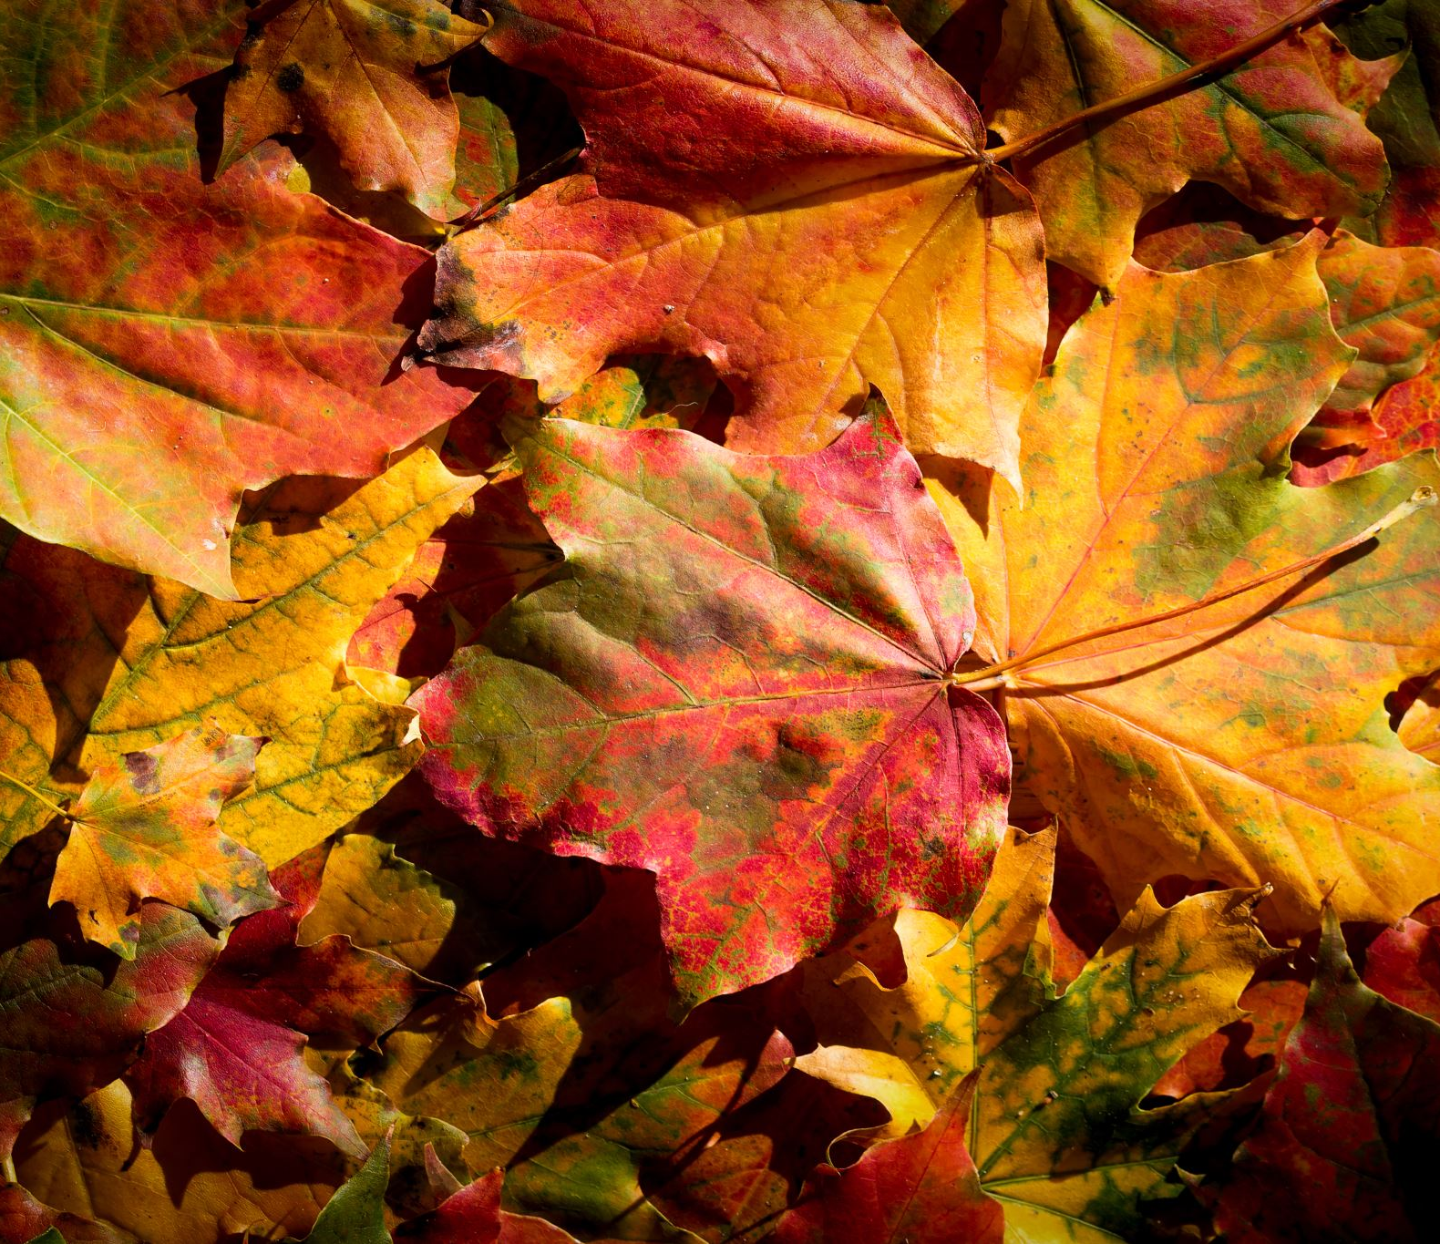
My truth and My Truth
How can following the path of my truth purify me In Preparation for my meeting with my Higher Truth so that we recognise one another?
Can I transform my earthly being into a raging river of Truth and fire of Love so that it burns and washes away all that isn’t real about me and exposes/ reveals my true identity and essence to both myself and those around me, providing a light and warmth to those around me?

Slide 60
My truth and my Truth
Have I tried cleaving to the Divine through prayer/meditation and charity? The Source of my Life? The Source of my Provision? The Source of my Truth? The Source of my Knowledge? The Source of my Wisdom? The Source of my Understanding? The Source of my Peace? The Source of my Love? The Source of my Forgiveness? The Source of my Mercy? The Source of my Compassion? The Source of Patience? The Source of my Strength? The Source of my Courage? The Source of my Humility? The Source of my Gratitude? The Source of my Respect? The Source of my Awe? The Source of my Perseverance and discipline? … To Whom Belong the Most Beautiful Attributes
The Source of all Divine Attributes that my human perception can perceive and strive to become one with?

Slide 61
My Truth and My Relationships
What is the relationship between my Truth, my Love, my Peace and my Light?
Am I able to transform myself and leap into a new dimension of Truth Love Peace and Light through Faith, trusting in that which I do not Know or yet understand and willingly surrender to the Source of my existence which is Above and beyond myself in Knowledge and understanding?
Am I able to spiral up in ascension through self reflection and oft-repentance and ‘letting go’ of that which I have been given, my need to be self sufficient and my want to have power and control- and cleave to a Will that belongs to my Creator, Provider and Sustainer, in order to find the hidden treasures of my soul that I did not know even existed?

Slide 62
My Truth and my Relationships
How does my truthfulness, sincerity and integrity affect my relationships?
Do my relationships help me to grow authentically? Do they help and allow me to be true to what I believe to be my true purpose?
Do my relationships with my family, friends, partner and others in my community enable me to explore truth and to express it? Does me being who I am and becoming who I am or want to become, help and encourage others to grow authentically in my relationship with them, giving them space to explore and to be true what they believe to be their Higher Purpose? If not- is who I am and want to become authentic by essence?
Am I committed to my relationships? Are those in my relationships committed to me? How does my truth affect my ability to be more truthful and committed to the promises and vows and oaths that I make with others that I have more lasting and meaningful relationships?
How can my relationships become more authentic through my seeking and expression of Truth through acts of loving kindness that show gratitude to my Source of Truth and all my blessings through service of others?
How can seeking truth help me to love others as myself and treat others how I want to be treated so that I can have more meaningful relationships while staying true to my purpose of serving my Source of Truth?

Slide 63
My Truth and my Relationships
Do I deceive my partner in my speech and behaviour by not expressing my true identity?
Do I become the expectations of my partner or do I become the expectations of my Creator and what I believe to be True?
Do I worship Truth or do I worship my partner? Do I worship Truth or do I worship my own understanding of it?
Do I allow room for my partner to express his or her true identity or do I exert control over my partner so that he or she speaks and behaves in a way that serves my own purpose?
Would my partner be with me if they knew my true identity? Would I be with my partner if I really knew their true identity?
Does my partner really love me for who I am and who I want to become? Do I love them for who they really are and who they want to become?
How can I experience true unconditional love if I am not true and sincere in my interaction with my partner?
Do I choose to put a veil over my vision and cover my ears and heart in order not to face the true reality of my false relationships? Who am I deceiving other than myself?
Why do my relationships not last? Is it because as soon as I uncover the essence of my true identity to another, they realise they do not love me? Or is it because as soon as my partner reveals their hidden nature which does not suit or serve my purpose- I am ready to break my commitment to them without taking any responsibility?
How can my truth help me to find, give and receive True Love and therefore stay more committed to trying to make my relationships work?
How can seeking truth help me to learn from my partner, and seek to understand and listen more to my partner’s perspective of truth instead of making them ‘wrong’ all the time?

Slide 64
My Truth and my Relationships
What is more important to me?
Having a Direct relationship with The Source of My Truth, or putting my partner in between us? Should my partner put me before his or her Source of Truth? Does this not divide Our Source of Truth into different ‘truths’ which cause division and separation between us?
Would it not work better if The Source of Our Truth was in between myself and my partner? So That each of us face Our Source and have a direct connection with Him, and through Him/and the sincere seeking of Truth and inclining towards it, we become One and Unite in Truth?

Slide 65
My Truth and my Relationships
Are my parents always correct? How do I know? Am I permitted to question my parents when I am supposed to honor them? Who is more worthy of my worship? My parents or The Source of our Truth?
Is my child always wrong? How do I know? Am I permitted to encourage my child to seek and stand up for Truth even if it goes against My opinion and advice? Who is more worthy of their worship- me or The Source of Our Truth?
Does my teacher always speak the Truth? How do I know? Are they not human like me? Can they not make mistakes and misguide without knowledge at times? Am I not allowed to question the authenticity of the source of their knowledge? Who is more worthy of my worship? My teachers, religious leaders and scholars? Or The Source of our Truth?

Slide 66
My Truth and my Relationships
What is more important to me?
Having a direct relationship with The Source of my Truth, or putting others in between myself and my Truth as deities which themselves rely on the Same Source of Truth for their knowledge?
Who shall I ask first for help?- my Source of Truth that is part of me, or my teacher? Doctor? Parent? Scholar? My Partner? My Children? Is it not more reliable to rely solely on my Source of Truth, Wisdom and Understanding to direct me to others and teach me through them ( if He chooses) , rather than to rely solely on others to direct me to The Source of My Truth?
Is there not danger where Truth is mixed with falsehood? How can my teachers and scholars and parents guide me better than my Creator and Source of Truth? Why would my Source of Truth require that others bring me close to Him? Is He not Able to do that Himself?

Slide 67
My Truth and my Relationships
Am I questioning the authenticity and Truth to all that I am reading right now? Am I relying on this to save me? If so- how can this save me? Is it separate from me? Or is it part of me? Am I not the one asking the questions here? Is it not I/Me that needs to do the work in order to be saved? To Question? To Ponder? To Think? To Pray? To Meditate? To Clarify? To use my logic and reason? To take responsibility of my own unique path to Truth, responsibility for my life, and seek my unique Higher Purpose in my Life? Who better to rely on than my Creator- The Source of Me? The Source of all Knowledge and Wisdom? To Whom everything belongs, To Whom everything returns?

Slide 68
My Truth and My Relationships
What is the purpose of Knowledge wisdom and understanding if I can not share it with others? How can I share that which I know with others without love and my relationship?
How can I maintain a meaningful and trusting relationship with another if I am not truthful, trustworthy or committed to Truth?

Slide 69
My Truth and my Relationships
How can truth help me to avoid slander and gossiping? How can this help me improve my relationships with others?
Is what I am about to say True? Am I 100% sure? What is my evidence?
Is it necessary?
Is it Kind?
If I am talking behind someone’s back- would I myself like it for another to speak this about me behind my back?

Slide 70
How can I Become more Truthful?
Have I tried…
Not lying?
Not stealing?
Not intentionally deceiving others for personal gain?
Not gossiping or slandering others?
Questioning the authenticity of what I am about to say before I say it?
Welcoming and encouraging others to question the truth of what I say?
Treating others how I myself would want to be treated?

Slide 71
How can I seek Truth with my Brain?
Have I tried…
Using my mind to question the Truth of what I read or hear or see or feel using my logic, reason and my intellect?
Self-reflection?
Mindfulness?
Taking time for disciplined prayer/meditation where I concentrate on the concept of Truth and other Divine Attributes so that it can help me see areas of myself that I need to work on?
Respectfully Listening to others about their perspectives of truth, to help me question myself and my truth in comparison?

Slide 72
How can I seek Truth with my Brain?
Have I tried…?
Not knowingly rejecting Truth through disobedience and arrogance once it has entered my mind and heart?
Letting go of the idea that my truth ‘belongs’ to me- by sharing it with others freely ( as my belief or opinion with reasons/evidence if possible) - without expectation of payment or return- unlearning everything that I have come to believe is The Truth- in order that I become a vessel of Light and Love?
Questioning my preconceived ideas/opinions/beliefs about my truth that have been taught to me by my parents/teachers/Rabbis/Scholars and looking for contradiction in my beliefs- Can these area of contradictions help to guide me to my Higher Truth?

Slide 73
How can I seek Truth with my Brain?
Have I tried…?
To listen to others in order to learn from their perspective, and letting go of all assumption or thought which tells me that ‘I know better than anyone else?’
Pondering in Awe, instead of mocking at everything and anything that is part of my perceived Reality? Can this help to open my Mind’s Eye to see Higher Reality hidden beneath the layers of my limited perception of awareness?

Slide 74
How can I seek Truth with my Brain?
Have I tried…
Learning from different perspectives of religion and science and culture using books, social media, film, podcasts, debates, while seeking help and guidance directly from my Source of Truth to help me make good judgement of right from wrong, Truth from Falsehood?
Accepting that just because my brain does not understand something yet, it does not mean that what I do not understand is not valid or truth.
Not being shy or afraid or too proud to admit when ‘I don’t Know…’

Slide 75
How can I seek Truth with my Brain?
Have I tried…
Not to rely solely on my Brain to help me break through those difficult paths to Higher Truth?
For how can I truly know what I have learnt if I do not put it into practice?
Can the knowledge and wisdom and understanding of Empathy and Love and Compassion be learnt through reading books alone?

Slide 76
How can I seek Truth with my Heart?
Have I tried…?
Falling in love with Truth, and all the Divine Attributes that are the Source of my Being so that I can emulate them, and incorporate them into each breath of Life that I breathe? In all that I think and say and do? But how can I make myself fall in love? How can I fall in love with That which I do not yet Know? Do I have the power and free will to choose this path?
Is this path of Divine Truth that I choose to become part of not Infinite? How do I begin? How do I get closer to Knowing The Infinite in all of my Ways?
Making a verbal declaration of surrender to the Path of Truth? And committing to this while trying my best to lead an honest and truthful life while treating others how I want to be treated?
When will the faith and Truth of The Presence of my Source of Truth enter my Heart? Does it come down from my brain? Is this when I will truly start to love my Creator with my heart mind and strength and love for others what I love for myself? Is this what defines me as ‘A Believer?’

Slide 77
How can I seek Truth with my Heart?
Have I tried….
Praying: with a sincere and humble heart directly to my Source? Calling unto Him like a child calling their parent? Speaking to Him like a Best Friend? Praying using my speech while meditating on each word that I speak from my heart – seeking help and guidance to improve myself, and praying for Mercy, Guidance and Forgiveness for all humanity, no matter if enemy or friend?
Seeking to make peace: Between people, loved ones, avoiding arguments and fights
Gratitude: To show gratitude to my Maker for all my blessings and gifts and provision and opportunities by sharing with those who have less than I do- to Glorify and Praise Him- out of Fear, Awe and Love?
Compassion: Trying to see the good in others? Seeing myself in others? Allowing others to see themselves in me?
Sacrifice: Do I not have something I can sacrifice? Is there not something that I have and love that I can bring as a sacrifice by sharing with those who want or need it?
Acts of loving kindness:
Reaching out a helping hand, a smile, or listening ear to someone in need of my help when possible?
Performing regular acts of charity: Giving beyond my needs, from my wealth?
Forgivness and pardoning of the sins of others, seeking forgiveness for those that have wronged me?

Slide 78
How can I seek Truth with my eyes?
Am I able to stare at the sun for long periods of time without a veil or cloud in between my sight and the sun? Does it not burn my vision and blind me to look at the sun? Am I able to see with my eyes the Essence of Truth? Is it not easier to stare at the sun when it is clouded over with layers of clouds? am I not more able to look directly at the moon- a reflected Light?
Is the sun ( or essence of Truth) within me not also clouded over so that I can engage with others without destroying their vision from staring directly at my true essence? Am I able to see the direct light of others when I look with my eyes? So how can I possibly ever expect to see the Source of all Light and Truth with my own physical eyes?
But perhaps I am able to see with my spiritual eyes? Is it my heart’s Eye that can see through the hidden layers of my soul that is also a part of You?
How can I look for the reflection of truth and light in others so that I am able to engage in a truth-seeking relationship of spiritual growth with and through them?

Slide 79
How can I see Truth with my eyes?
What do I understand by Blind Faith? Can Blind Faith lead me astray? What is the danger of blind faith? Will I not be questioned for not questioning my faith?
Should I obey and worship that which I choose to obey and worship without questioning it?
Does my Faith bring me to a level of awareness of Truth where I no longer rely on my limited ability to clarify right from wrong using my intellect alone? To a level where the Faith in my Heart is what guides me, where I surrender myself completely to a Will that is Higher than my own? An Understanding that is Higher than my Own?

Slide 80
How can I seek Truth in all my Ways?
What or Who do I choose to worship? Who or what do I obey? Do I worship that which I choose to obey? Do I Obey that which I choose to worship? And why? Can I truly rely on that which I choose to worship and obey?
Do I obey and worship: My truth? My religion? My culture? My parents? My partner? My Emotions? My Intellect? My animalistic desires? My ego? Are these not all merely creations of The Creator and of man? Are any of these beyond myself or are they merely different parts of me? Do any of these parts of me have a right to be worshipped? Does not all right of worship and obedience belong to my Creator? The Creator of me and you? The Source of all Reality? The Source of All Knowledge and wisdom and understanding and Love and ultimately Truth?
Do I worship my own understanding of reality or a Reality that is not limited by my own perception and space?
How can I refine myself and purify myself of falsehood in order to reveal my true essence of my Truth- if I do not seek help from that which is Above myself from within myself?
How Able am I to remember My Source in everything that I think, feel, hear, see, speak and do? Will this help to

Slide 81
One Truth, many Paths
Have I yet come to the realization that I am nothing more than dust and ashes? That in each speck of dust of my being exists a whole universe of gold and treasure that only he who seeks will find? I seek not to create new definitions of Truth or Love according to my own will and understanding- for neither of these belong to me, but to my Creator who is the Source of Everything. I am nothing more than a willing servant- neither am I separate: even though I may appear to be divided– because everything that I temporarily become, changing from form to form, with every breath I take in this physical world is not for me but for You. I am One with the journey which inclines towards Truth- which seeks to connect and unite all paths through love, peace and Justice- by reminding myself and the infinite souls that are part of me- whether willing or unwillingly; that we cannot escape our responsibility or desire to worship our Creator through our service to one another.
Am I ready to proclaim a heavy Word that has been cast upon me?

