Slide 1
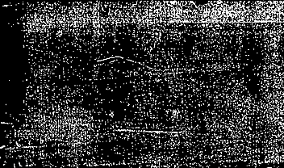
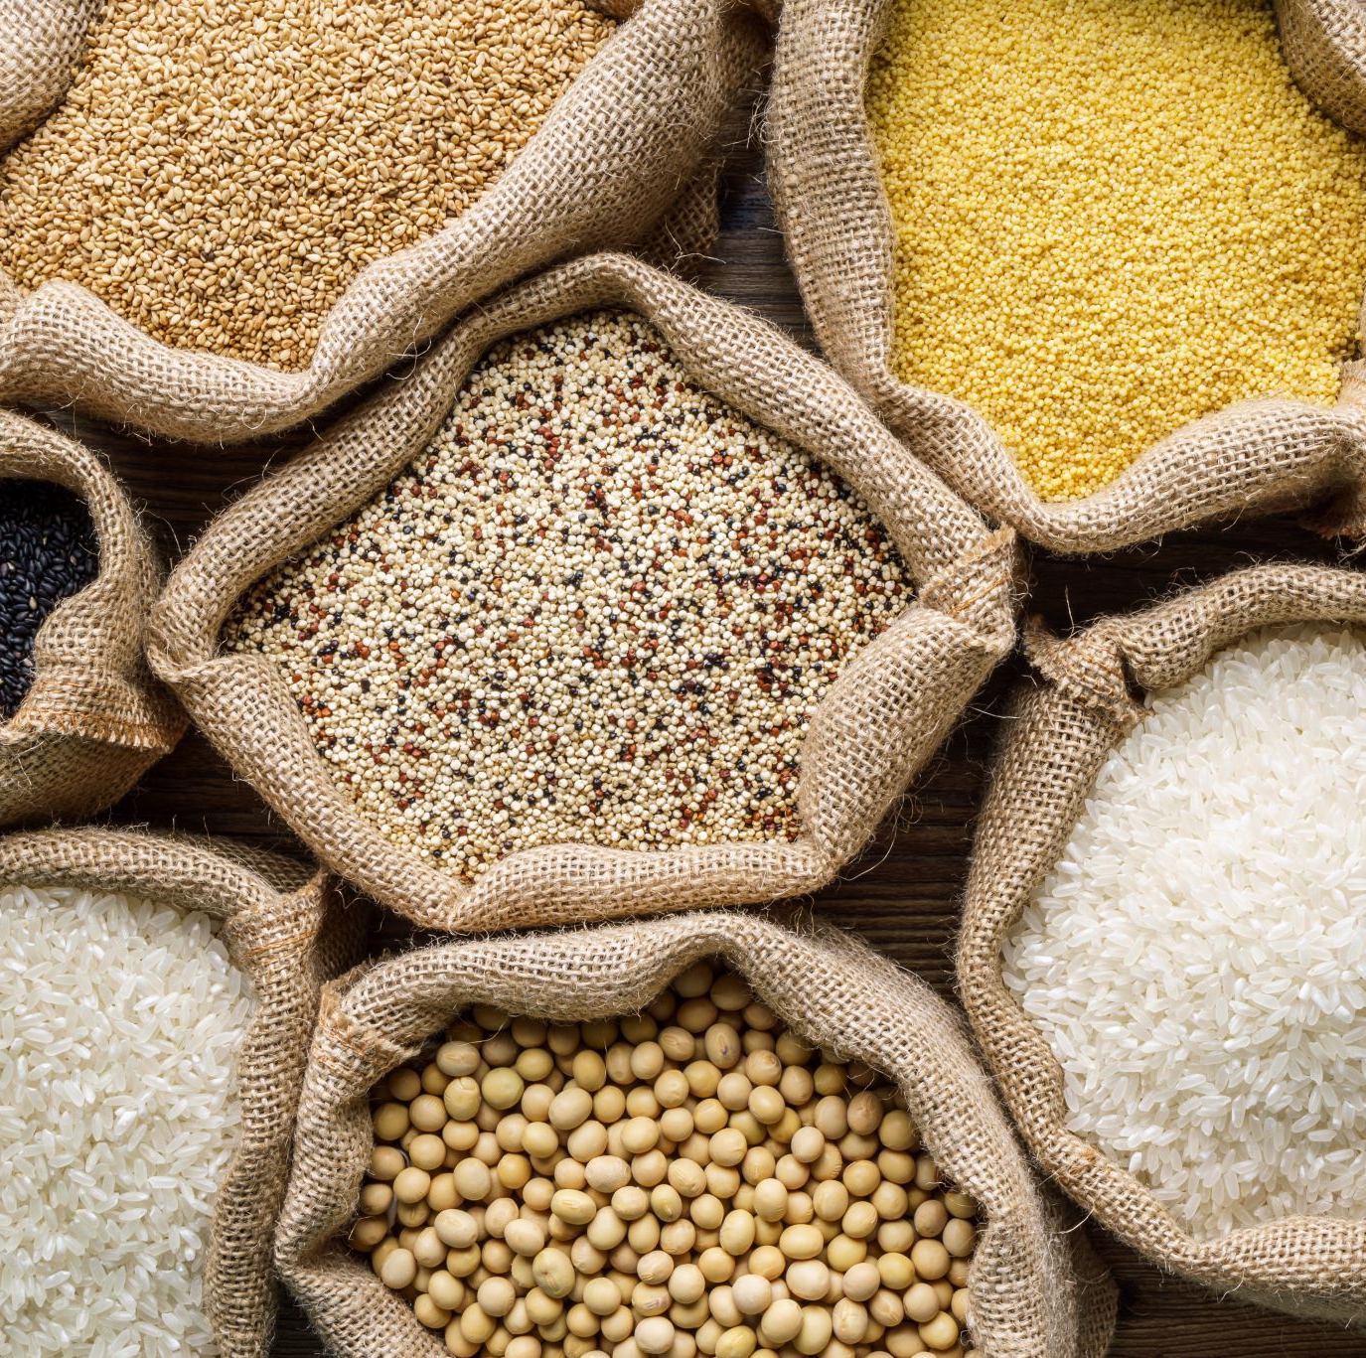

My Greed
My Responsibility

Slide 2
My Greed
What do I desire for myself?- and why?
What does ‘success’ mean to me? How does getting what I want relate to my success?

Slide 3
My Greed
How will getting what I desire for myself benefit me?
How will getting what I desire for myself affect other people?

Slide 4

My Greed
In order to get what I desire, must anyone else lose what they desire?
In order to get what I desire- must anyone else lose what they need?

Slide 5
My Greed
Am I willing to make sacrifices from what I love- in order to get what I desire? What am I willing to sacrifice? How will my sacrifices help others? How will my sacrifices affect others? Will my sacrifices have a negative impact on the thoughts and feelings of others? Will this make me feel more deserving to get what I really desire? Do I expect others to make sacrifices so that I can get what I desire for myself? How would I feel if others expected me to sacrifice from what I myself wants or needs so that they can get what they want?

Slide 6
My Greed
How will getting what I desire for myself make me feel? What emotions do I expect to have? How do I hope and expect these emotions will impact on how I will behave towards others and why?
How will getting what I desire for myself make others feel?

Slide 7
My Greed
Do I deserve to have what I desire for myself?- if so- how?
Do I deserve to have what I desire for myself, more than others deserve it? If so- how?
Do I ‘need’ what I desire for myself? -if so- how?
What are my needs? Are my needs different to others that I love?- how are they different?

Slide 8
My Greed
What do I understand by the word ‘waste?’. How do I feel to see others ‘waste’ what is beyond their needs? What if I knew that the waste of others made them feel ‘better’ about themselves or suited them well? Would I then be happy to see them waste what could potentially help those who need it more?

Slide 9
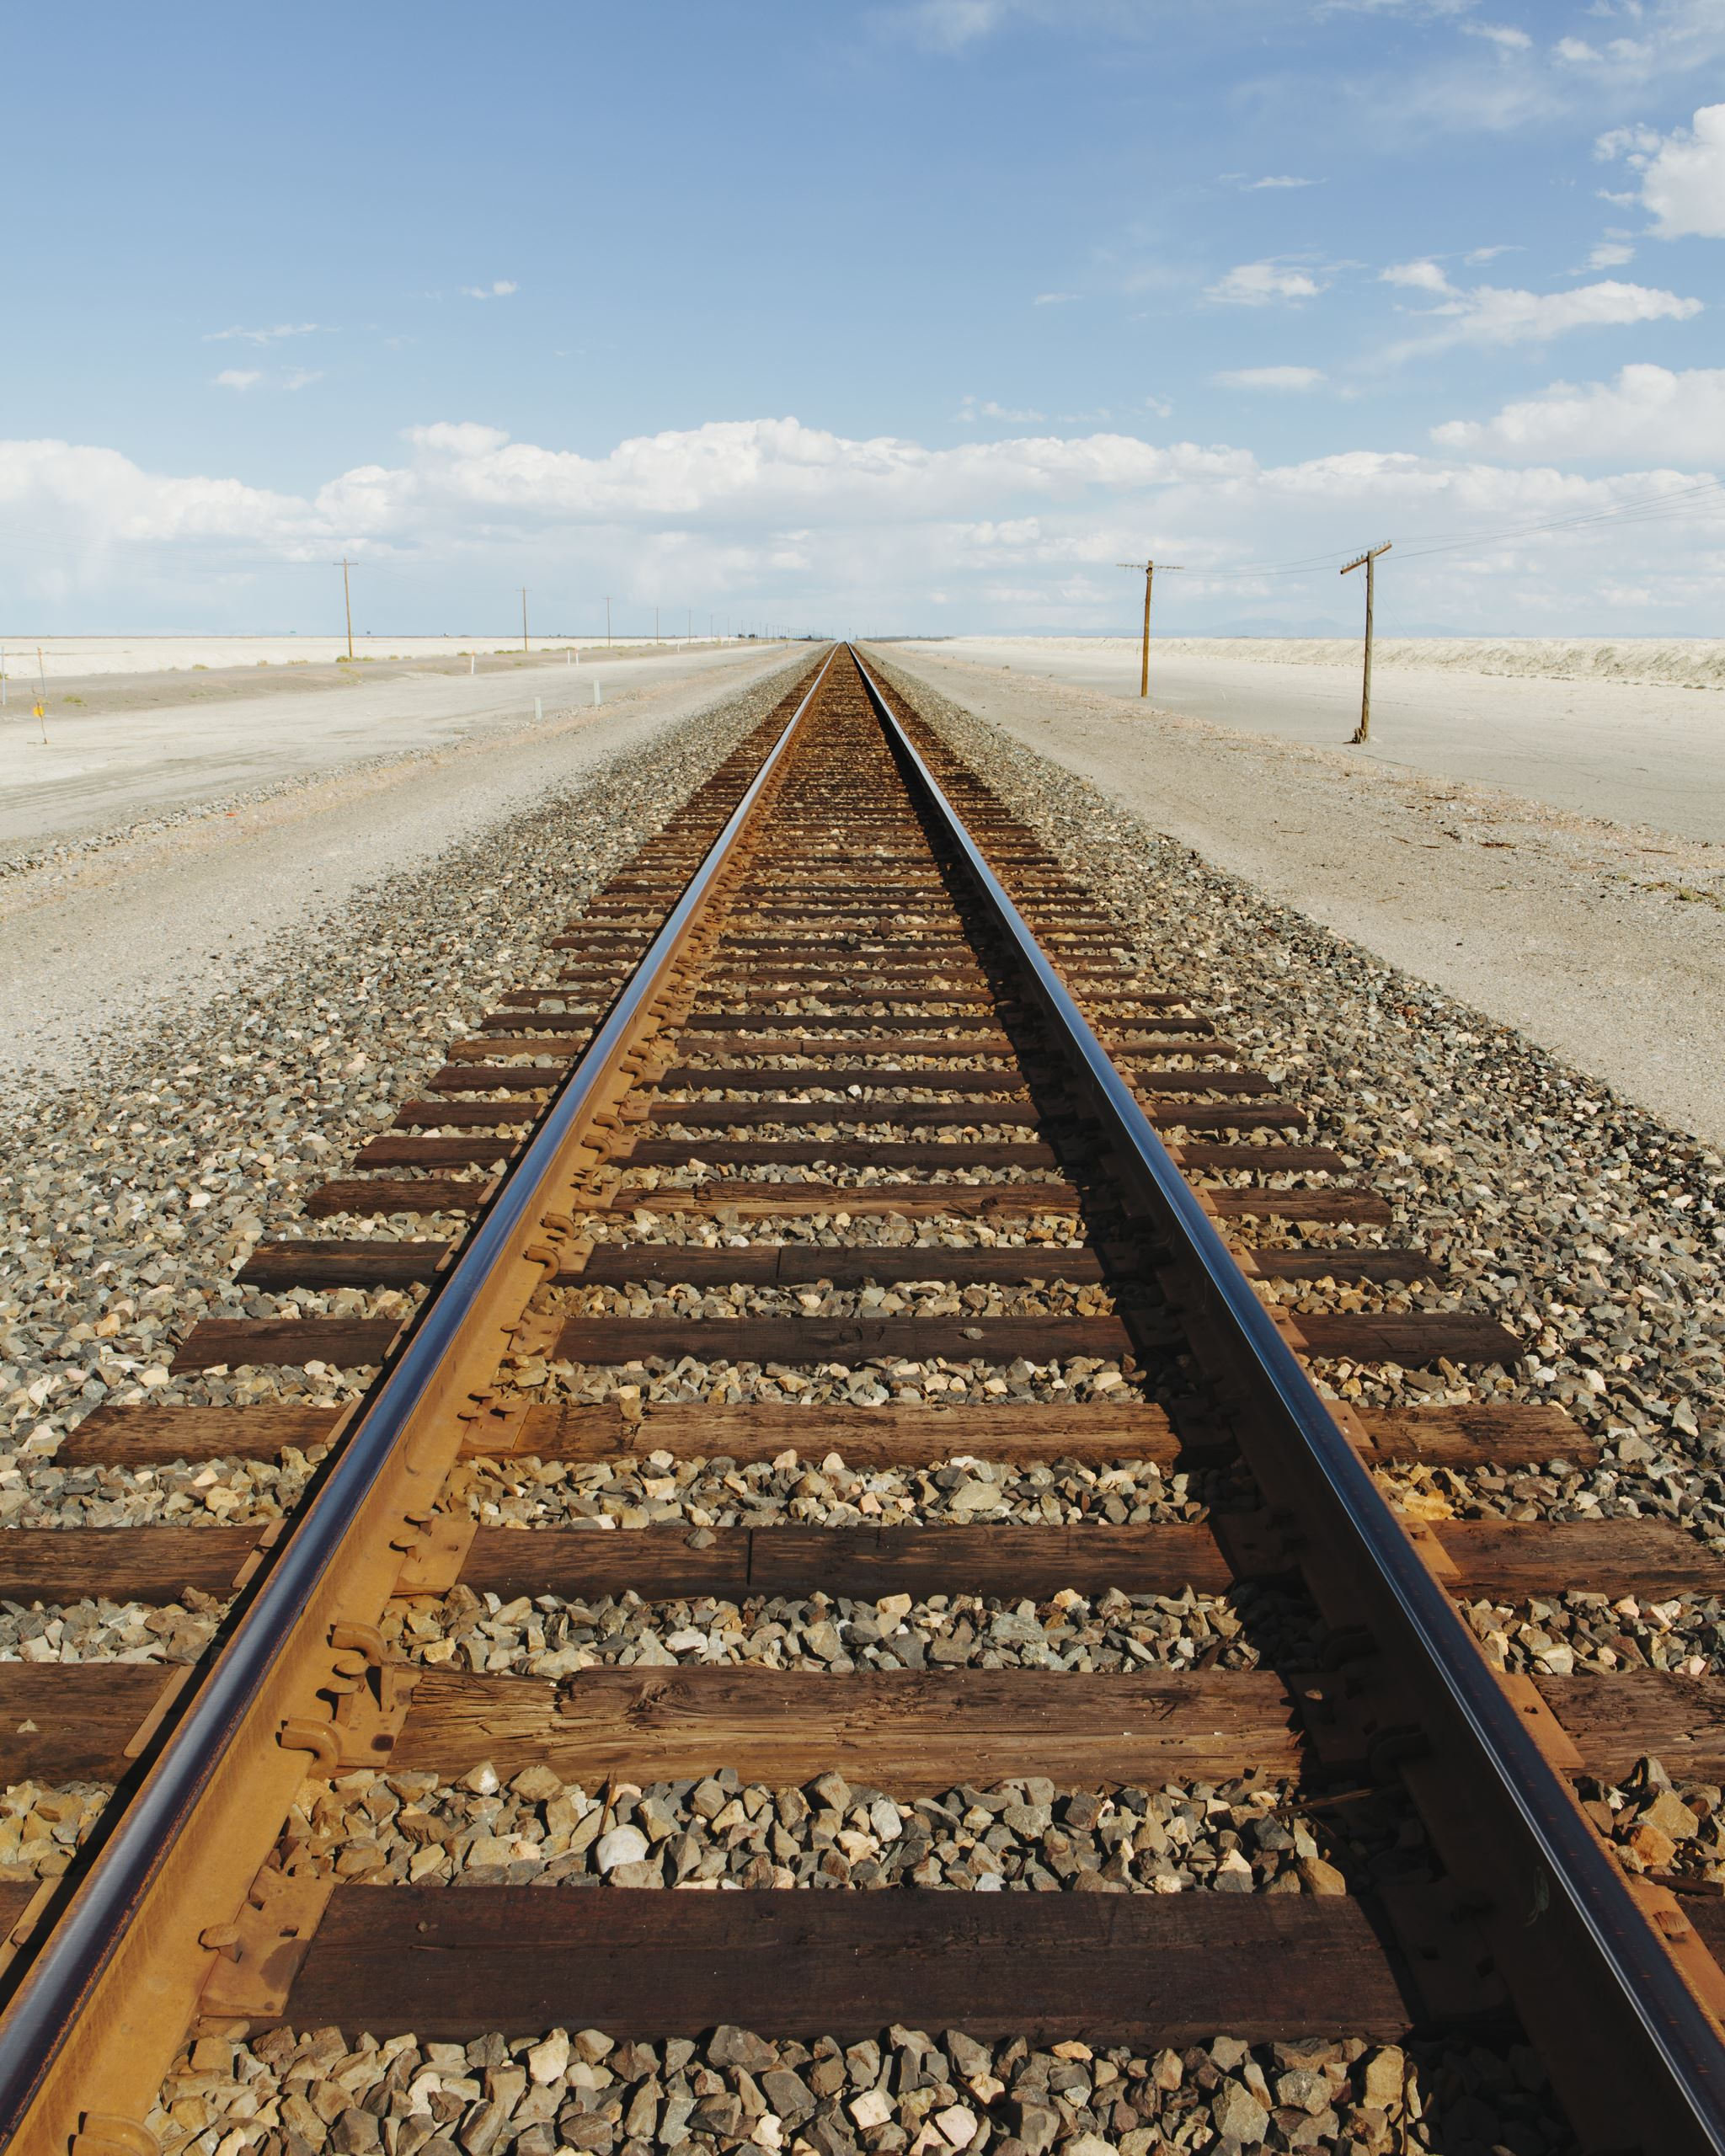
My Greed
Am I wasteful? If so- in what way? For everytime that I gain that which I desire for myself ( beyond my needs) and do not use it in order to help someone else- am I being wasteful? If not- how so? Do I have a right to expect others not to be wasteful- if what I define as waste from my perspective in fact benefits the greedy person?

Slide 10

My Greed
What do I ‘love’ in life? Do I desire to ‘possess’ or gain that which I love? Do I like to share what I love with others? Why do I love that which I love? How does it make me feel? Does it make me happy to see that which I ‘love’ be used by others who need it more than I do? Do I have ‘respect’ for that which I love? Does it matter to me to whom that person or thing that I love belongs to? Does that which I love – love me? Do I deserve to spend time with that which I love? Does that which I love deserve to spend time with me? What if that which I love could choose not to belong to myself? What if he or she does not want to spend time with me? How would this make me feel? Would I respect the choices that he or she makes, even if it means that I must experience pain and loss myself?
What do I understand by ‘unconditional love?’

Slide 11
My Greed
What do I understand by ‘unconditional love?’
Have I ever felt what I understand as ‘unconditional love’ for someone or something? Is this feeling temporary? Or do I still feel it? Has it changed? Does it depend on something else? If so- how can it be unconditional?
Do I allow my unconditional love for someone or something- affect my speech and behaviour in a way that is unjust or untrue? Am I prepared to go against even myself and my unconditional love for someone or something in order to serve Truth?

Slide 12
My Greed
What do I understand by the term ‘life’? What do I understand by the term ‘death’? Do I believe in ‘life after death?’
Am I frightened of death? IF not- why? Am I ready to die for what I really love? – If not- why? Am I ready to die for what I believe to be True, even if it is not what I love?
Does what I desire to have in this world, have the ability to save me from death? Do I believe that I am able to take what I love for myself in this world with me to the afterlife?

Slide 13
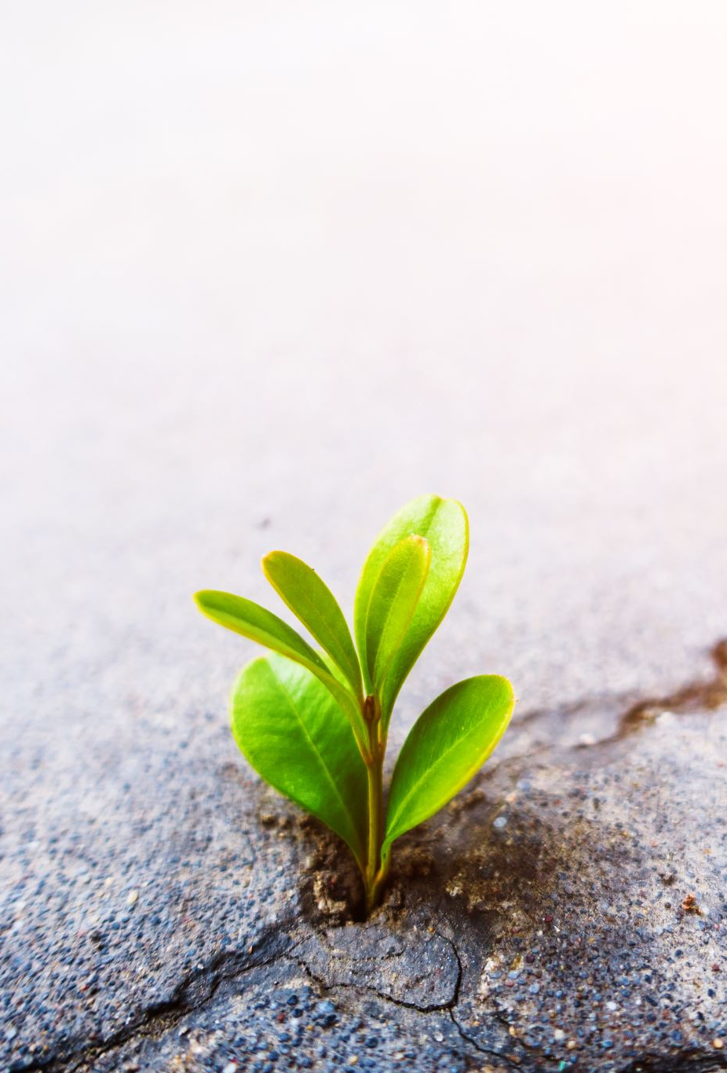
My Greed
So What is ‘success’ to me? Is my understanding of success the same as the understanding of ‘success’ from a Higher Perspective? Is my understanding of success- the Truth? If so- what evidence do I have that it is Truth?

Slide 14
My Greed
Imagine if all the material possessions that belong to me could speak- what would you expect they would say to me? What would I reply? What if they told you that me do not deserve to have them in my possession ? Would I think I am going crazy? Can money speak for itself? Or would I believe it was speaking truth?

Slide 15
My Greed
Now imagine that the most impoverished, poor, and needy person in the world is speaking to God during times of affliction and in desperation- calling out to Him like a baby whines for a mother. What words do I imagine he or she might be saying? Imagine if this person knew My Name. What would they be saying about Me? Would God speak back in my defence? If so- what makes me think God would stand up for me?

Slide 16
My Greed
Have I ever been a victim of someone else’s greed? If so- what made me percieve that person to be ‘greedy?’ How did their ‘greed’ affect how I feel about myself? How did their greed affect the emotions of others? Did I see any harm come to others because of that person’s greed?

Slide 17
My Greed
If I had a choice to be able to take the material wealth from someone that was greedy, ungrateful and unkind- and give it to the poor and needy who I knew would share their wealth in order to help relieve suffering of others- would I do so? If not- why not?

Slide 18

My Greed
How does getting what I desire for myself make me feel about myself? Does it make me feel more ‘worthy’ of love from others? Does it make me feel more worthy of ‘respect’ from others? Does it make me feel more worthy of having ‘control’ over the behaviour of others? Does it make me feel more ‘valuable’ in my own mind about myself?

Slide 19
My Greed
How does getting what I desire for myself make me feel about my Faith in a Higher Existence or Power other than myself?
Does it Please The Higher Power to see that I ‘gain’ from the ‘loss’ of others? If so why does this Please Him? What evidence do I have for this?
Do I feel confident in my excuses to myself or God about how I chose to use my blessings in this worldly existence?

Slide 20
My Greed
Do I believe in a Higher Power than myself? Do I believe that He is ‘Just’ and ‘Righteous’ and If so- how does getting what I desire for myself affect How He should treat me? Is His love for me dependent on what I choose to do with what I have for myself in order to help others- or is His Love for me unconditional and not dependent on how I behave? Would He punish me for the sake of Justice and Truth even if it goes against His unconditional love for me? Do I treat others how I expect He would treat me?

Slide 21
My Greed
If I have/had a child- would I give him or her what he or she wanted if I could see that he or she was causing harm to themselves and others with what I have given him or her? Would I go against my ‘want’ to see him or her ‘happy’ and pleased due to my unconditional love for them, in order to stand up to what I believed to be just and ‘right’?

Slide 22
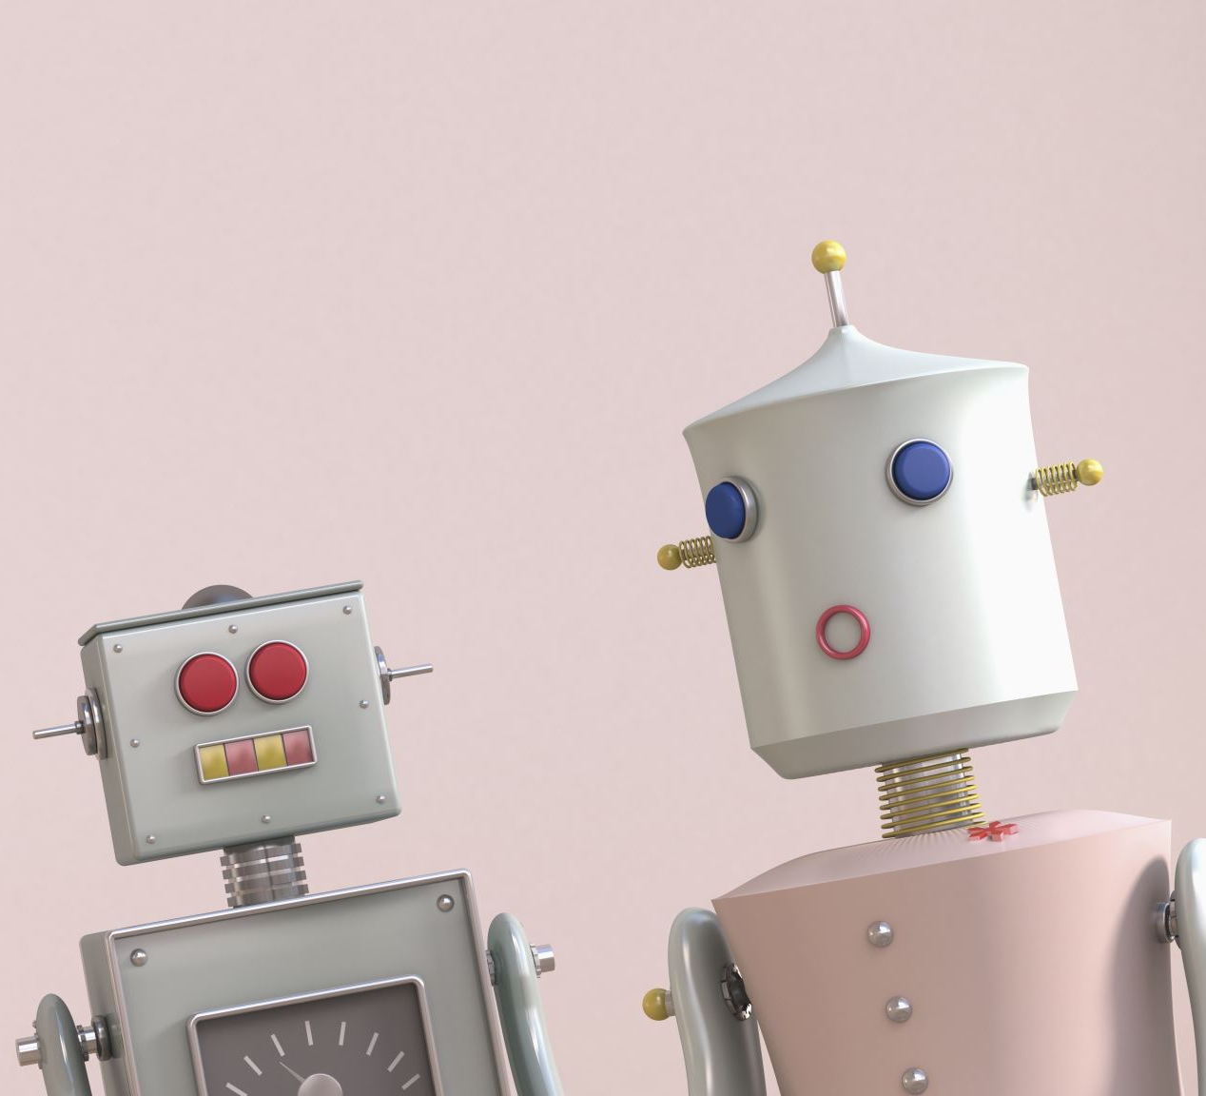
My Greed
How does my greed affect the relationship I want to have with those I love? Can I think of any examples?
Do I love my Greed more than I love those I want to have a relationship with?
How would I feel if I owned the whole world- but had no one to share it with? Would I be happy?

Slide 23
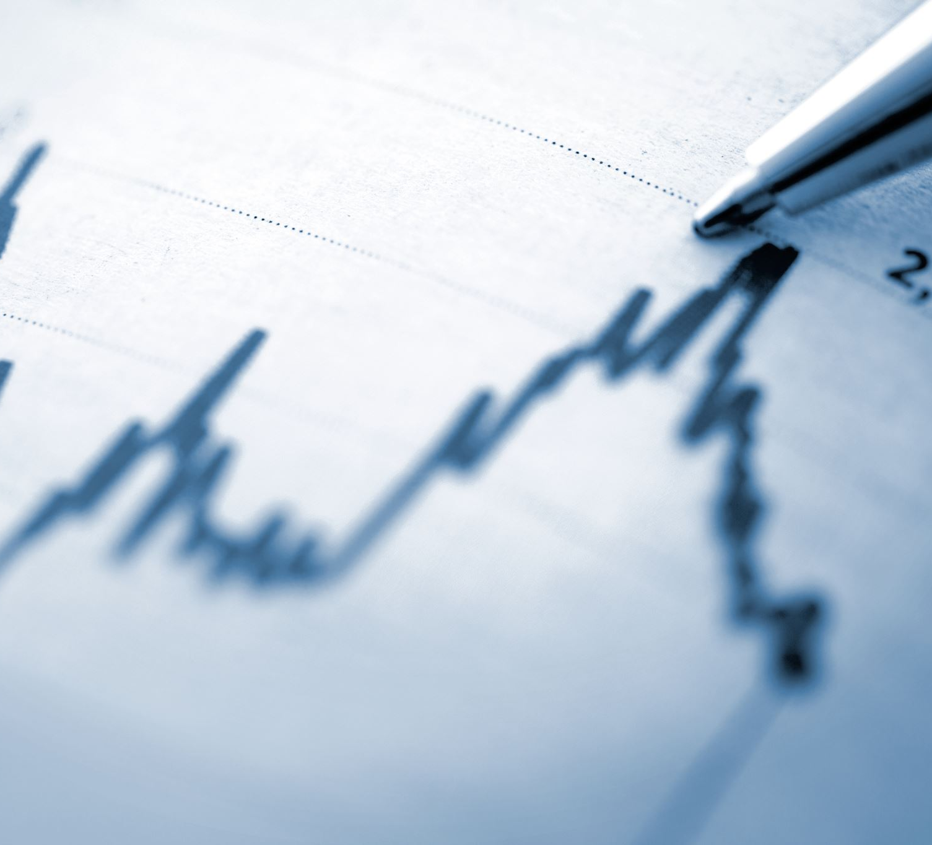
My Greed
Do I have control over my Greed?
Or does my greed control the way I behave?
Do I want to have control over my Greed?
What do I want to worship?

Slide 24
The Greed of others
What do I desire for others? Is what I desire for others for their own benefit or for mine?
Do I love for others what I would love for myself?

Slide 25
The Greed of others
How does it make me feel when I see that others get what I wanted for myself?
How does It make me feel to know that others have their basic needs met?

Slide 26

The Greed of others
Do I put the needs of others before my own need?- If so- what emotion drives this? How does this make me feel about myself?
Do I put the wants of others before my own wants? If so- what emotion drives this? How does this make me feel about myself?

Slide 27
The Greed of others
How does it make me feel that others have beyond their needs, but also their ‘wants’ and desires too?
How does it make me feel to see others ‘take’ from others what is not rightly theirs in order to get what they want?

Slide 28
The Greed of others
How would it make me feel to know that every single living creature on this planet had all its needs met? Can I imagine a world like this? Is this ‘possible’ from my understanding? What role does greed play in this? As long as greed exists- how can this be achieved?

Slide 29
The Greed of Others
How roles do the emotions of envy, pride, anger, vengeance, sloth, and lust play in my Greed and the Greed of others for the ‘want’ of temporary material possessions for selfish gain?

Slide 30
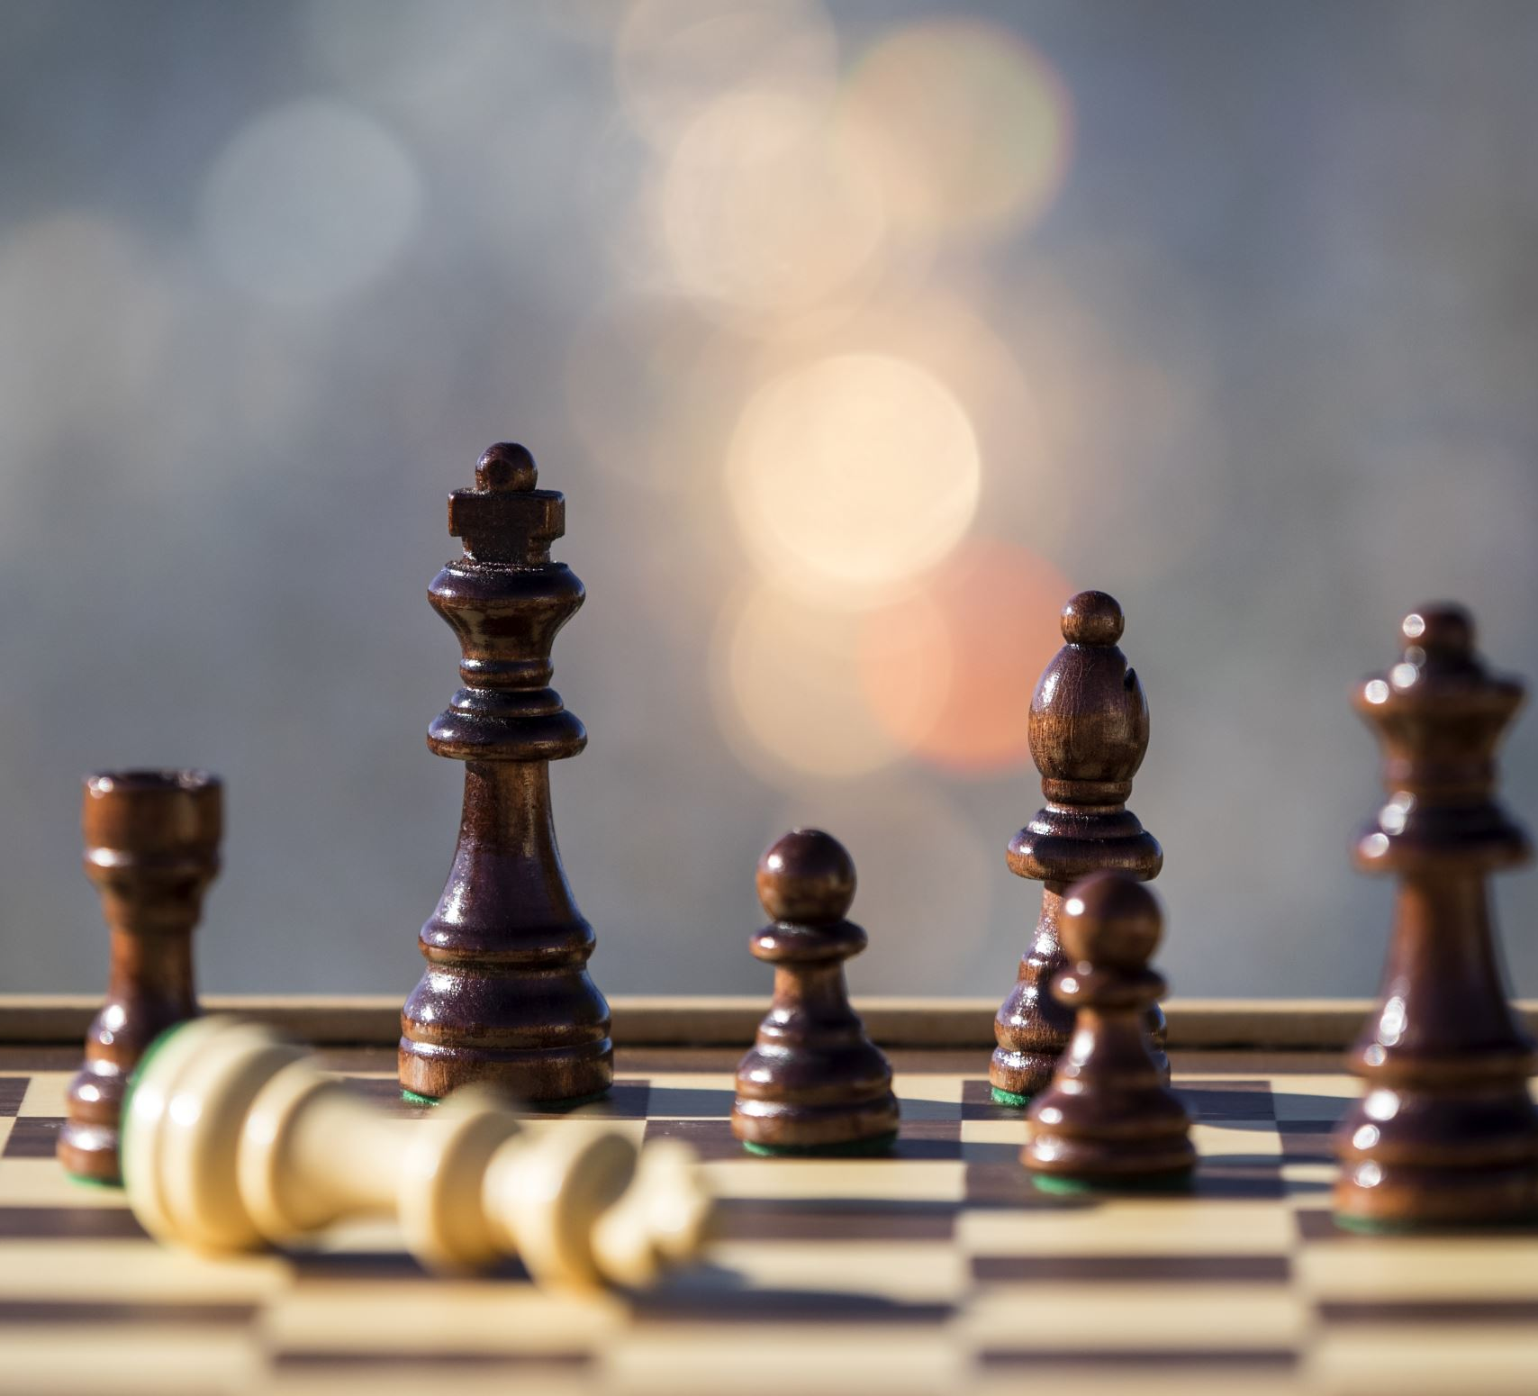
The greed of others
Do I have control over the greed of others? Why do I want to have control over the greed of others?
Do I have control over my own desire of greed? If not- what gets in the way of myself and control over my greed? What do I think will help me to gain control over my emotion of greed?

Slide 31
The Reflection of My Greed
Do I want to gain control of my Greed? If not- why not? If I do not gain control over my greed, do I take responsibility for the consequences this may have on myself and others? Do I have a right to complain about my own suffering when I now know that my own greed can potentially cause suffering to others?

Slide 32

The Reflection of Greed
Do I treat others how I myself want to be treated? If not- why? Do I expect others to treat me how they want to be treated? If so -why?
Am I worthy of Forgiveness? If not- why?
Do I feel remorse about my past greed? If so- why?
Am I grateful for my blessings? How does my gratitude level affect my ‘worthiness’ of having what I desire for myself and others?
How can I best express my gratitude for my blessings through my behaviour?

Slide 33
The Reflection of my Greed
What is more important to me- to be loved unconditionally, or to love others unconditionally? And why?
Do I expect others to treat me right, even if they do not love me? Do I do what I believe to be true, even if it goes against my greed?

Slide 34
The Transformation of my Greed
Am I prepared to sacrifice what I love for myself, in order to do what I believe is ‘right’ to benefit others?
Am I ready to put my words into action and use my blessings in a way that helps others/ a Higher Cause than myself?
Am I willing to accept my own loss in order to be part of a Higher Cause other than myself, and helps others who need my desires more than I do?
What opportunities are present in my life that can enable me to transform my Greed into acts of selflessness and unconditional love?
Would I be more willing to accept and feel worthy of unconditional love from another, if I understood and experienced this feeling myself?

